Slide 1
A New Course Offering
Robbie Weber
With assistance from: Sam Ainsworth, Sami Davies, Colin Lockard, Jennifer Rogers

Slide 2
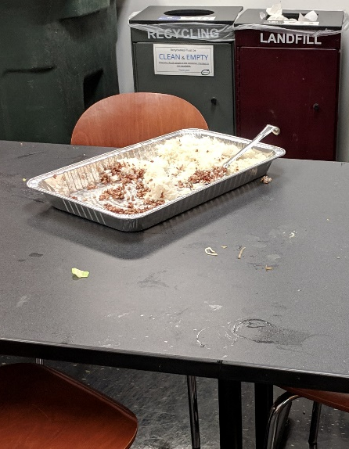
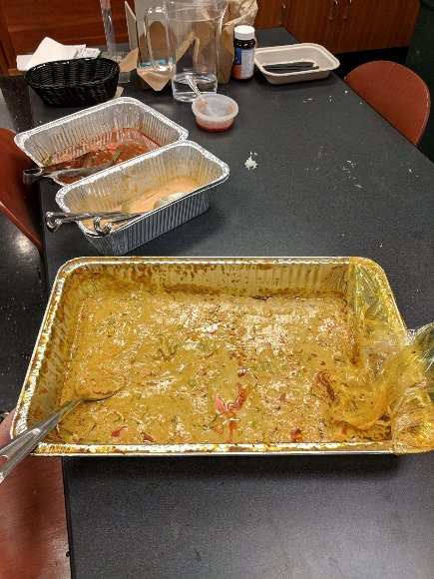
At HotPoCSci
Jennifer and I told you about the Rice Curry Problem
And asked for your help.

Slide 3

We need experts in:
Robotics
Vision
Machine Learning
Theory
AND MORE

Slide 4
At HotPoCSci
Jennifer and I told you about the Rice Curry Problem
And asked for your help.
Did you help us?

Slide 5
Lessons Learned
Don’t just describe a problem, describe a solution
CSE students must be exhausted
Why else would you not have helped?

Slide 6
The Problem
We’re all exhausted
It’s really hard to take a nap in CSE

Slide 7
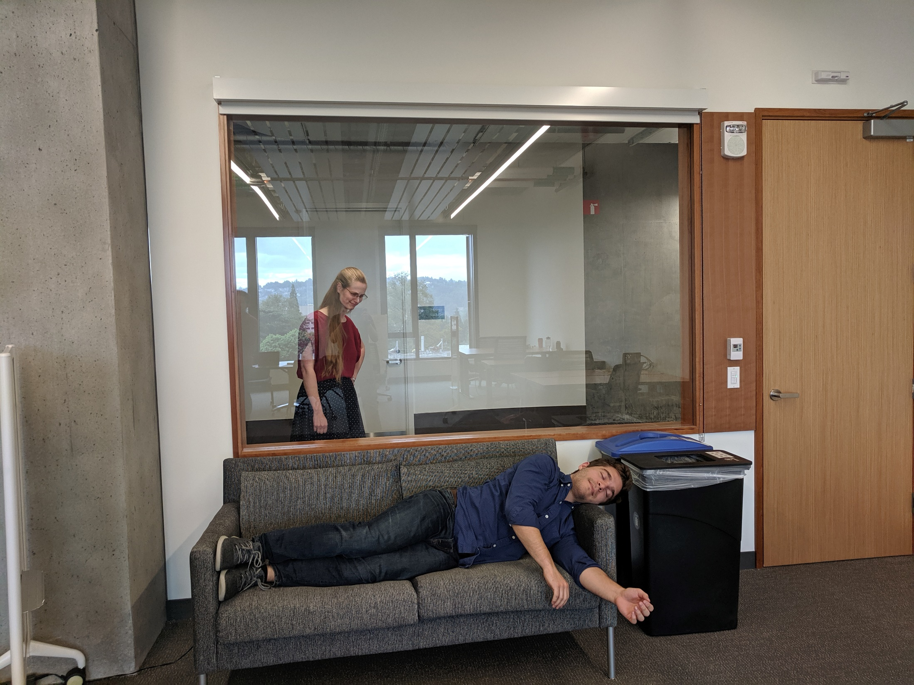
The Problem: Ineffective naps
Couches are uncomfortable
Arms are empty
Lack of privacy

Slide 8
The Problem:
We’re all exhausted
It’s really hard to take a nap in CSE
Couches are uncomfortable
Arms are empty
Lack of privacy

Slide 9
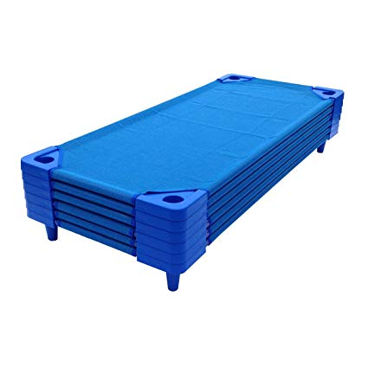


Problem 1: Ineffective Couches
Nap time is well-understood in the preschool community
They don’t use couches.

Slide 10

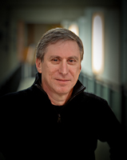


CSE Carpeting Hierarchy
Literally everyone else

Slide 11
Problem 1: Ineffective Couches
Nap time is well-understood in the preschool community
They don’t use couches.
Solution: new-director-approved-carpet-squares

Slide 12

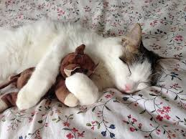


Problem 2: Nothing to Hug
No matter who you are
Napping is easier with something to hug

Slide 13
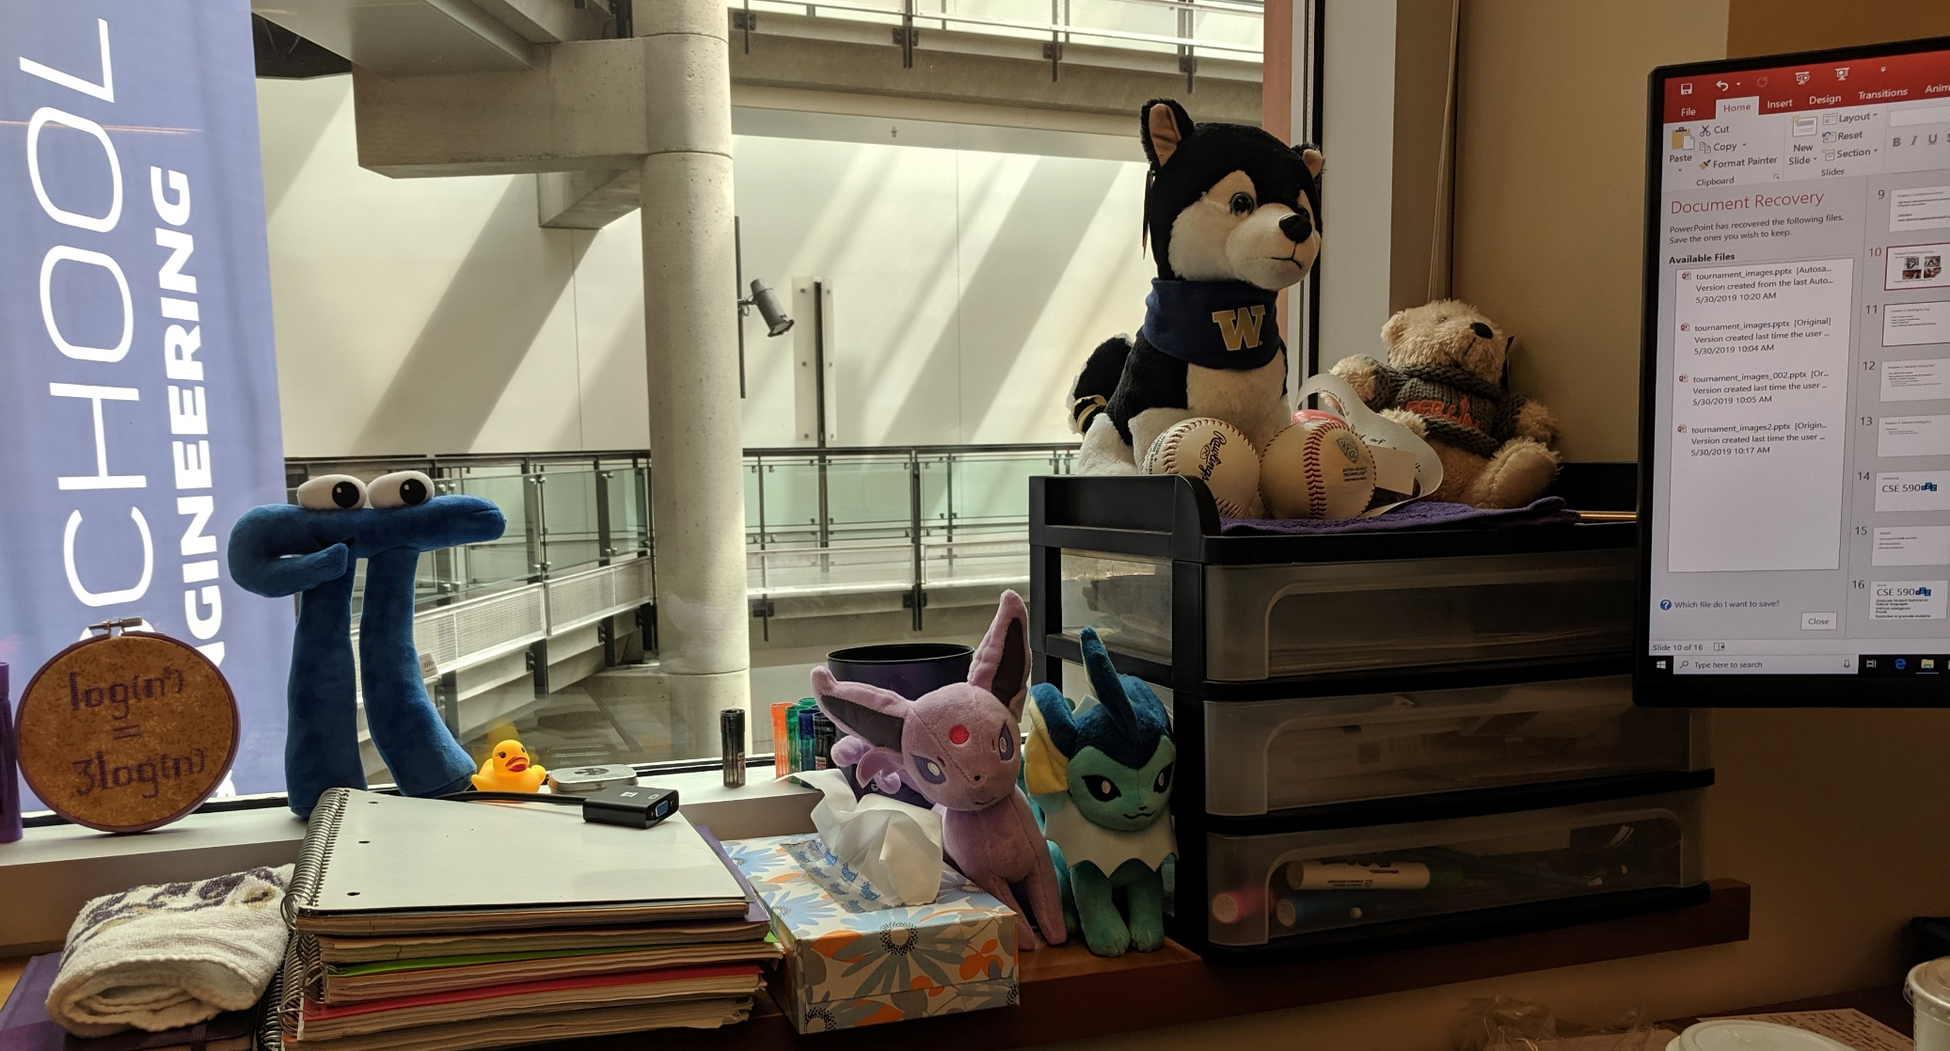
Problem 2: Nothing to Hug
Napping is easier with something to hug. Can’t we just use my stuffed animals?
4
5
1
2
3

Slide 14
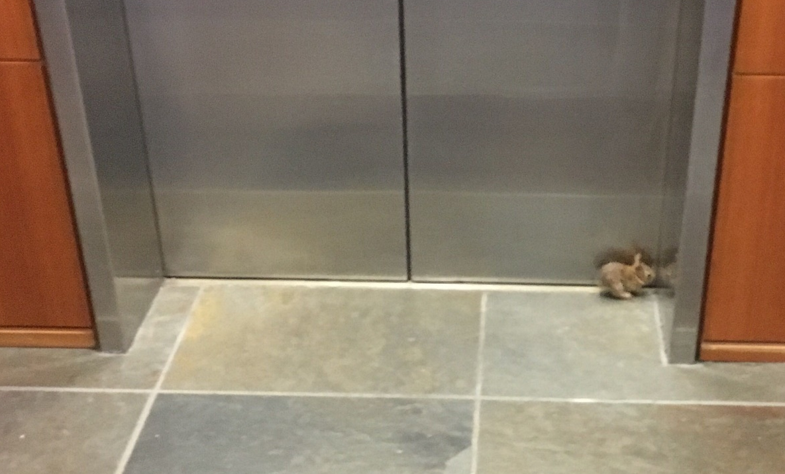
Better option
Photo Credit: Srini Iyer

Slide 15
Problem 2: Nothing to Hug
Step 1: Capture bunny
Step 2: Capture second bunny
Step 3: [redacted]
Step 4: NAPTIME BABY BUNNIES FOR EVERYONE

Slide 16
Problem 3: Advisors Finding Out
Our offices have windows
New conference rooms are literally all windows
CSE 403 is an ideal nap-space
No windows or other natural light
Easy to move desks
Speakers have been removed to prevent accidental loud noises

Slide 17
Problem 3: Advisors Finding Out
How do we:
Make sure CSE 403 is reserved?
Ensure our advisors think we’re busy?

Slide 18

Introducing…
CSE 590

Slide 19
Caution
Do not confuse CSE 590 with CSE 590Z
590Z is Theory Seminar. [insert your own joke here]

Slide 20
Join us!
CSE 590
Seminar on
Natural language processing
Architecture
Programming languages
Theory
Image processing
Machine learning in Computer Science &
Engineering
Restricted to graduate students

